Slide 1

Tendo Attrition model
Presented by:
Data Science
Update: 20th March 2025

Slide 2
Attrition model: Concepts of Onboarding Cohorts and Observation Window
 | 2023 |  |  |  |  |  |  |  |  |  |  |  | 2024 |  |  |  |  |  |  |  |  |  |  |  | 2025
 | Jan | Feb | Mar | Apr | May | Jun | Jul | Aug | Sep | Oct | Nov | Dec | Jan | Feb | Mar | Apr | May | Jun | Jul | Aug | Sep | Oct | Nov | Dec | Jan
Train data [24 784]: randomly selected performance window start point
 | …..... | …..... | …..... | …..... | …..... | …..... | …..... | …..... | …..... | …..... | …..... | …..... | …..... | …..... | …..... | …..... | …..... | …..... | …..... | …..... | …..... | …..... | …..... | …..... | ….....
Test data [18 797]: randomly selected performance window start point
We take only those Employees who are Active Employees with that Employer AND Active Tendo Customers as of the Performance Start Date
We calculate the Features for those Employees and their Employers as of the Performance Start Date
Then we calculate the Employee's performance (Job Attrition flag and Months to Attrition from Performance Start Date) during the Performance Window (12 month).

Slide 3
Features: feature selection pipeline
Employer related features:
Churn rate
Onboarded employees
Employer industry
JobStreet data
Employee related features:
Age
Gender
Civil status
Employment status
Duration of employment
Job title based features
Email based features
Phone based features
66
Feats
59
Feats
59
Feats
40
Feats
13
Feats
Remove rare
binary features:
< 0.05
Standardization and log transformation of numerical features
Pairwise correlation analysis:
correlation < 0.8
Multicollinearity analysis:
VIF < 10
Selecting only significant features:
p-value < 0.05
Loan's history related features:
Number of active loans
Total OSBal
Max loan amount taken in last X months
Avg loan amount over last X months
Total loans taken in last X months
Self repayment flag
Early repayment flag
GCash disbursement channel flag
So, in the end, all selected features are those that: 1. do not have high correlation
2. do not exhibit high multicollinearity
3. do not have rare categories
4. are statistically significant
Month related features:
Dec/Jan/Feb/Jul/Aug in next 3/6 month
Month

Slide 4
Features: selected features list
# | Feature name | Type
1 | Employer Industry = Others (=not BPO) | Binary (1/0)
2 | Salary rating on JobStreet = Low | Binary (1/0)
3 | Employment status = Regular | Binary (1/0)
4 | The duration of employment (in months) | Numerical (log transformed and standardized)
5 | Company size on JobStreet = 51-100 | Binary (1/0)
6 | CSR job title | Binary (1/0)
7 | Average loan amount in last 3 months = 2500+ | Binary (1/0)
8 | Company size on JobStreet = Missed | Binary (1/0)
9 | Number of onboarded employees = 250-1000 | Binary (1/0)
10 | December in next 6 months | Binary (1/0)
11 | Popular email domain | Binary (1/0)
12 | Total outstanding balance as of calc date = 5-10k | Binary (1/0)
13 | Age of employee | Numerical (standardized)
Features are ordered by their impact on hazard ratio (higher in the list = higher impact)

Slide 5
Model: performance per cohorts
This table shows the predictive power of our employee attrition model using the Concordance Index (C-index).
The C-index measures how well our model distinguishes between employees who will leave versus those who will stay. It ranges from 0.5 to 1.0, where:
0.5 = no better than random guessing
0.6-0.7 = fair predictive ability
0.7-0.8 = good predictive ability
Above 0.8 = excellent predictive ability
Our model achieves a C-index of 0.67 on training data and 0.66 on test data, which means:
When comparing two employees—one who leaves and one who stays—our model correctly identifies the higher-risk employee about 66% of the time. This represents a meaningful 32% improvement over random selection.
The small difference (0.01) between training and test performance suggests that the model generalizes well to new employees not seen during training.
However, performance fluctuates over time, with the lowest C-Index in May 2024 (0.624) and the highest in September 2024 (0.672), indicating potential seasonality or evolving workforce patterns.
Conclusion: The model provides a fairly reliable ranking of attrition risk, but its performance over time suggests the need for ongoing monitoring and potential recalibration to maintain predictive strength.
Cohorts | Concordance Index
Train | 0.666
Test (combined) | 0.657
Test (calc date – Jan 2024) | 0.643
Test (calc date – Mar 2024) | 0.634
Test (calc date – May 2024) | 0.624
Test (calc date – Jul 2024) | 0.643
Test (calc date – Sep 2024) | 0.672
Test (new employees: history < 3m) | 0.666
Test (existing employees: history >= 3m) | 0.647

Slide 6
Model: performance per risk category
Actual Attrition rate, %
Calculation date | Very high | High | Average | Low | Very low
2024-01-01 | 72.6% | 52.0% | 38.3% | 31.5% | 20.5%
2024-03-01 | 51.6% | 46.1% | 38.7% | 20.7% | 13.8%
2024-05-01 | 44.9% | 39.3% | 27.2% | 17.9% | 13.1%
2024-07-01 | 42.4% | 36.0% | 24.1% | 18.4% | 8.2%
2024-09-01 | 30.0% | 27.5% | 15.7% | 11.9% | 5.7%
Share of risk categories, %
Calculation date | Very high | High | Average | Low | Very low
2024-01-01 | 8.0% | 47.5% | 20.8% | 7.0% | 16.7%
2024-03-01 | 7.2% | 40.0% | 24.7% | 11.0% | 17.1%
2024-05-01 | 6.2% | 41.0% | 26.4% | 10.9% | 15.4%
2024-07-01 | 2.8% | 34.9% | 30.8% | 14.9% | 16.6%
2024-09-01 | 3.5% | 33.6% | 22.3% | 15.2% | 25.5%

Slide 7
Appendix
​

Slide 8
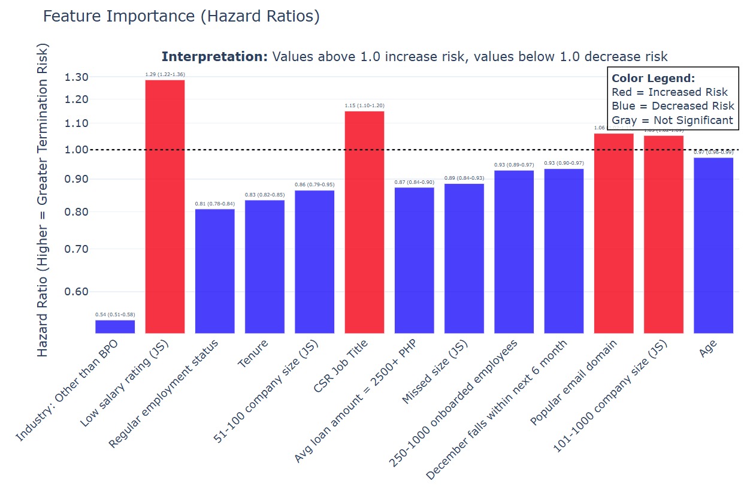
Model: performance per risk category

Slide 9
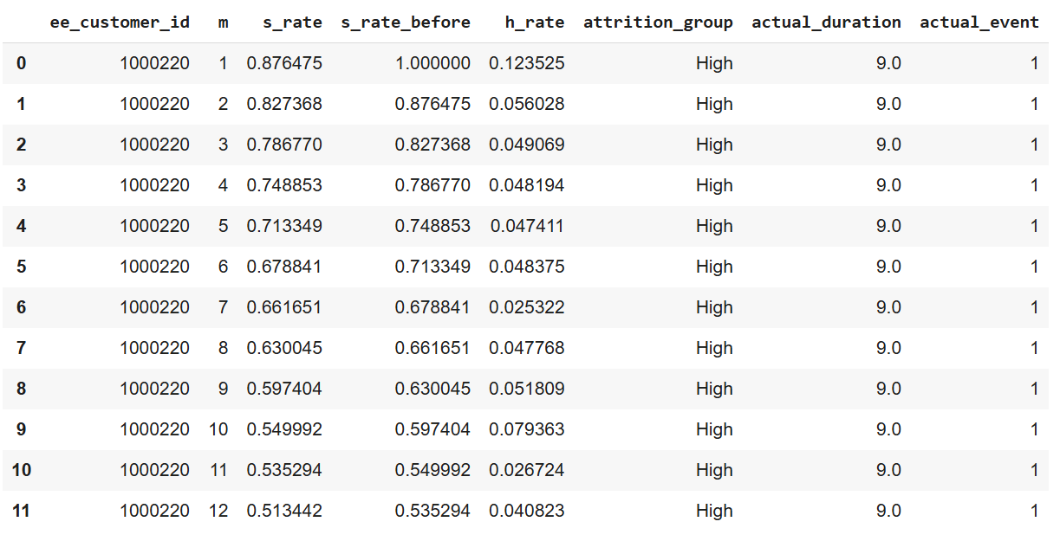

Model: risk category definition logic

Slide 10
Model: performance per risk category
Actual time-to-event per risk group [All]
Calculation date | Very high | High | Average | Low | Very low
2024-01-01 | 5.1 | 7.2 | 8.8 | 9.4 | 10.3
2024-03-01 | 7.5 | 8.1 | 8.9 | 10.4 | 10.9
2024-05-01 | 7.9 | 8.6 | 9.8 | 10.7 | 10.8
2024-07-01 | 7.9 | 8.6 | 9.8 | 10.4 | 11.2
2024-09-01 | 9.1 | 9.4 | 10.5 | 10.9 | 11.4
Actual time-to-event per risk group [resigned only]
Calculation date | Very high | High | Average | Low | Very low
2024-01-01 | 2.5 | 2.7 | 3.6 | 3.8 | 3.5
2024-03-01 | 3.2 | 3.6 | 4.1 | 4.4 | 4.2
2024-05-01 | 2.9 | 3.5 | 3.8 | 4.5 | 3.2
2024-07-01 | 2.4 | 2.7 | 2.7 | 3.1 | 2.8
2024-09-01 | 2.2 | 2.7 | 2.5 | 3.0 | 2.1

